Slide 1

Working with DB using Java. Performing CRUD
operation
Java Full Stack Program

Slide 2
Working with DB using Java - JDBC
JDBC stands for Java Database Connectivity. JDBC is a Java API to connect and execute the query with the database. It is a part of JavaSE (Java Standard Edition). JDBC API uses JDBC drivers to connect with the database. There are four types of JDBC drivers:
JDBC-ODBC Bridge Driver,
Native Driver,
Network Protocol Driver, and
Thin Driver.
Java Full Stack Program

Slide 3
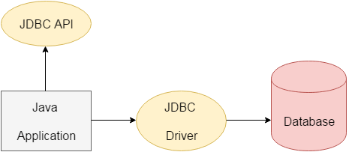
We can use JDBC API to access tabular data stored in any relational database. By the help of JDBC API, we can save, update, delete and fetch data from the database. It is like Open Database Connectivity (ODBC) provided by Microsoft.
Java Full Stack Program

Slide 4
The current version of JDBC is 4.3. It is the stable release since 21st September, 2017. It is based on the X/Open SQL Call Level Interface. The java.sql package contains classes and interfaces for JDBC API. A list of popular interfaces of JDBC API are given below:
Driver interface
Connection interface
Statement interface
PreparedStatement interface
CallableStatement interface
ResultSet interface
ResultSetMetaData interface
DatabaseMetaData interface
RowSet interface
Java Full Stack Program

Slide 5
A list of popular classes of JDBC API are given below:
DriverManager class
Blob class
Clob class
Types class
Why Should We Use JDBC
Before JDBC, ODBC API was the database API to connect and execute the query with the database. But, ODBC API uses ODBC driver which is written in C language (i.e. platform dependent and unsecured). That is why Java has defined its own API (JDBC API) that uses JDBC drivers (written in Java language).
Java Full Stack Program

Slide 6
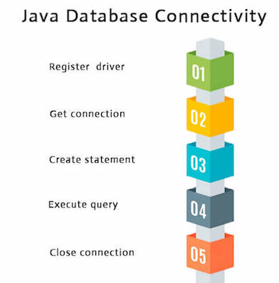
Java Database Connectivity with 5 Steps
There are 5 steps to connect any java application with the database using JDBC.
These steps are as follows:
Register the Driver class
Create connection
Create statement
Execute queries
Close connection
Java Full Stack Program

Slide 7
1) Register the driver class
The forName() method of Class class is used to register the driver class. This method is used to dynamically load the driver class.
Syntax of forName() method
public static void forName(String className)throws ClassNotFoundException
2) Create the connection object
The getConnection() method of DriverManager class is used to establish connection with the database.
Java Full Stack Program

Slide 8
Syntax of getConnection() method
1) public static Connection getConnection(String url)throws SQLException
2) public static Connection getConnection(String url,String name,String password)
throws SQLException
3) Create the Statement object
The createStatement() method of Connection interface is used to create statement. The object of statement is responsible to execute queries with the database.
Syntax of createStatement() method
public Statement createStatement()throws SQLException
Java Full Stack Program

Slide 9
4) Execute the query
The executeQuery() method of Statement interface is used to execute queries to the database. This method returns the object of ResultSet that can be used to get all the records of a table.
Syntax of executeQuery() method
public ResultSet executeQuery(String sql)throws SQLException
Java Full Stack Program

Slide 10
5) Close the connection object
By closing connection object statement and ResultSet will be closed automatically. The close() method of Connection interface is used to close the connection.
Syntax of close() method
public void close()throws SQLException
Java Full Stack Program

Slide 11
JDBC Driver
JDBC Driver is a software component that enables java application to interact with the database.
There are 4 types of JDBC drivers:
JDBC-ODBC bridge driver
Native-API driver (partially java driver)
Network Protocol driver (fully java driver)
Thin driver (fully java driver)
Java Full Stack Program

Slide 12
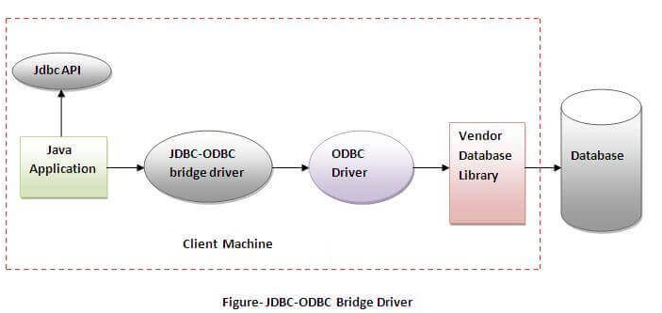
1) JDBC-ODBC bridge driver
The JDBC-ODBC bridge driver uses ODBC driver to connect to the database. The JDBC-ODBC bridge driver converts JDBC method calls into the ODBC function calls. This is now discouraged because of thin driver.
Java Full Stack Program

Slide 13
Oracle does not support the JDBC-ODBC Bridge from Java 8. Oracle recommends that you use JDBC drivers provided by the vendor of your database instead of the JDBC-ODBC Bridge.
Advantages:
easy to use.
can be easily connected to any database.
Disadvantages:
Performance degraded because JDBC method call is converted into the ODBC function calls.
The ODBC driver needs to be installed on the client machine..
Java Full Stack Program

Slide 14
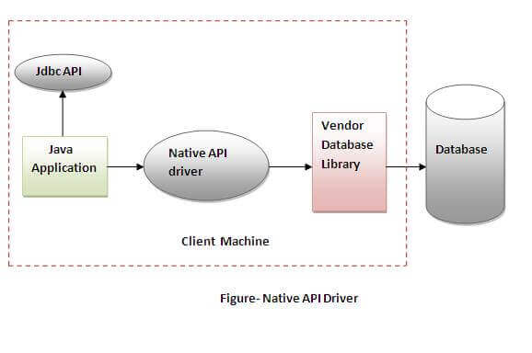
2) Native-API driver
The Native API driver uses the client-side libraries of the database. The driver converts JDBC method calls into native calls of the database API. It is not written entirely in java.
Java Full Stack Program

Slide 15
Advantage:
Following are the advantages of the type2 driver.
This type of driver fastest among all the 4 types of drivers.
If we use this driver, we can also access the features provided by the database vendor.
Disadvantage:
Following are the disadvantages of a type2 driver.
On the client machine, the Java Application calls are converted into vendor-specific database calls. Therefore, we must install native libraries on the client machine.
Since the native functions are executed on the client machine a small error in their execution can cause severe damage.
This driver causes more cost.
Java Full Stack Program

Slide 16
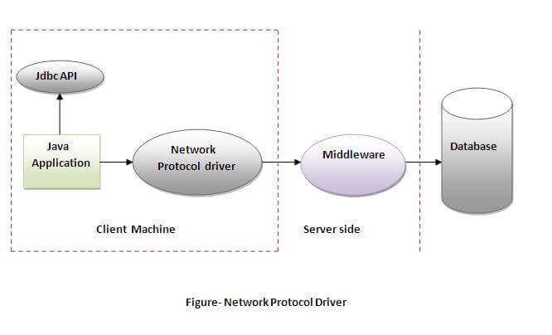
3) Network Protocol driver
The Network Protocol driver uses middleware (application server) that converts JDBC calls directly or indirectly into the vendor-specific database protocol. It is fully written in java.
Java Full Stack Program

Slide 17
Advantage:
No client side library is required because of application server that can perform many tasks like auditing, load balancing, logging etc.
Disadvantages:
Network support is required on client machine.
Requires database-specific coding to be done in the middle tier.
Maintenance of Network Protocol driver becomes costly because it requires database-specific coding to be done in the middle tier.
Java Full Stack Program

Slide 18
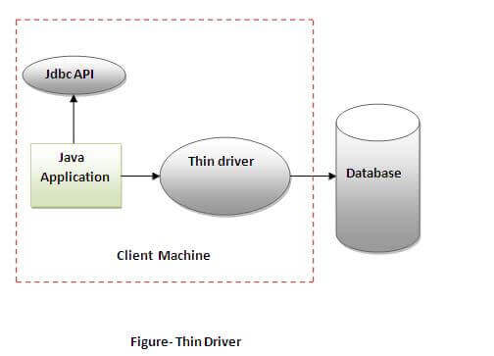
4) Thin driver
The thin driver converts JDBC calls directly into the vendor-specific database protocol. That is why it is known as thin driver. It is fully written in Java language.
Java Full Stack Program

Slide 19
Advantage:
Better performance than all other drivers.
No software is required at client side or server side.
Disadvantage:
Drivers depend on the Database.
Java Full Stack Program

Slide 20
Performing CRUD operation
What is CRUD?
CRUD is an acronym that comes from the world of computer programming and refers to the four functions that are considered necessary to implement a persistent storage application: create, read, update and delete. Persistent storage refers to any data storage device that retains power after the device is powered off, such as a hard disk or a solid-state drive. In contrast, random access memory and internal caching are two examples of volatile memory - they contain data that will be erased when they lose power.
Java Full Stack Program

Slide 21
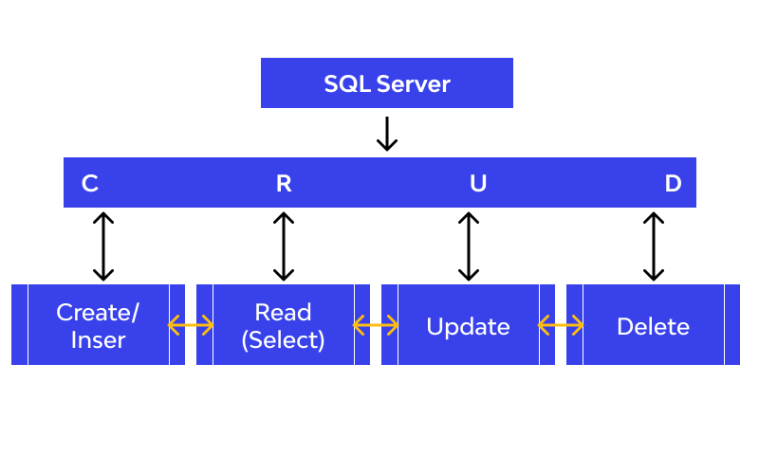
CRUD operations
Java Full Stack Program

Slide 22
CRUD operations
Organizations that keep track of customer data, accounts, payment information, health data, and other records require data storage hardware and applications that provide persistent storage.
This data is typically organized into a database, which is simply an organized collection of data that may be viewed electronically. There are many types of databases: hierarchical databases, graph databases, and object-oriented databases to name a few.
The most commonly implemented type of database is a relational database, which consists of data tabled in rows and columns and connected to other tables with complementary information by a system of keywords that includes primary keys and foreign keys.
Java Full Stack Program

Slide 23
Four CRUD operations components explained
A relational database consists of tables with rows and columns.
In a relational database, each row of a table is known as a tuple or a record.
Each column of the table represents a specific attribute or field. The four CRUD functions can be called by users to perform different types of operations on selected data within the database.
This could be accomplished using code or through a graphical user interface. Let's review each of the four components in-depth to fully appreciate their collective importance in facilitating database interactions.
Java Full Stack Program

Slide 24
Create
The create function allows users to create a new record in the database. In the SQL relational database application, the Create function is called INSERT. In Oracle HCM Cloud, it is called create. Remember that a record is a row and that columns are termed attributes. A user can create a new row and populate it with data that corresponds to each attribute, but only an administrator might be able to add new attributes to the table itself.
Read
The read function is similar to a search function. It allows users to search and retrieve specific records in the table and read their values. Users may be able to find desired records using keywords, or by filtering the data based on customized criteria. For example, a database of cars might enable users to type in "1996 Toyota Corolla," or it might provide options to filter search results by make, model and year.
Java Full Stack Program

Slide 25
Update
The update function is used to modify existing records that exist in the database.
To fully change a record, users may have to modify information in multiple fields.
For example, a restaurant that stores recipes for menu items in a database might have a table whose attributes are "dish," "cooking time," "cost" and "price." One day, the chef decides to replace an ingredient in the dish with something different. As a result, the existing record in the database must be changed and all of the attribute values changed to reflect the characteristics of the new dish.
In both SQL and Oracle HCM cloud, the update function is simply called "Update."
Java Full Stack Program

Slide 26
Delete
The delete function allows users to remove records from a database that is no longer needed. Both SQL and Oracle HCM Cloud have a delete function that allows users to delete one or more records from the database.
Some relational database applications may permit users to perform either a hard delete or a soft delete.
A hard delete permanently removes records from the database, while a soft delete might simply update the status of a row to indicate that it has been deleted while leaving the data present and intact.
Java Full Stack Program

Slide 27
CRUD applications
CRUD operations are widely used in many applications that are supported by underlying relational databases. These four basic CRUD functions are incredibly versatile in how they can support a variety of important functions across different business models and industry verticals. Let's look at an example of how CRUD is implemented.
An enterprise organization maintains a human resources department that helps manage to staff and keep track of existing employees. The HR department manages a relational database application with various tables that track different types of employee information:
Java Full Stack Program

Slide 28
CRUD applications
CRUD operations are widely used in many applications that are supported by underlying relational databases. These four basic CRUD functions are incredibly versatile in how they can support a variety of important functions across different business models and industry verticals. Let's look at an example of how CRUD is implemented.
An enterprise organization maintains a human resources department that helps manage to staff and keep track of existing employees. The HR department manages a relational database application with various tables that track different types of employee information:
Java Full Stack Program

Slide 29
An Employees Table includes attributes such as first and last name, employee identification number, contact number, home address, work location, and any other relevant personal details.
An HR Data Table that includes the employee's payroll information, social security number, employee ID and salary.
A Locations Table that contains attribute data for each of the company's physical locations, including building ID, address, zip code, the name of the manager, etc.
Java Full Stack Program

Slide 30
Benefits of CRUD
Many programmers prefer CRUD to ad-hoc SQL statements because of its speed. The execution plan for a stored procedure is saved in SQL Server's procedure cache and reused for all subsequent calls to the procedure.
When SQL Server executes a SQL statement, the relational engine checks the procedure cache to determine if an existing execution plan for that SQL statement exists, and if so, it uses that plan to reduce the need for SQL statement optimization, parsing, and recompiling.
If an execution plan isn't found, SQL Server will generate a new execution plan for the query. Furthermore, when SQL statements are removed from application code, all SQL can be stored in the database, leaving only stored procedure calls in the client application. Using stored procedures can help to reduce database coupling.
Java Full Stack Program

Slide 31
Benefits of CRUD
Additionally, performing CRUD operations protects against SQL injection attacks. Since all SQL Statements employ stored procedures instead of string concatenation to generate dynamic queries from user input data, everything entered into a parameter is quoted.
Java Full Stack Program

Slide 32
THANK YOU
Java Full Stack Program

